Slide 1
Figures – Chapter 8

Slide 2
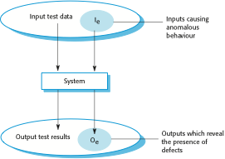
Figure 8.1 An input-output model of program testing

Slide 3
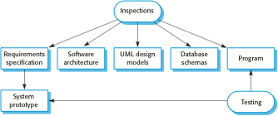
Figure 8.2 Inspections and testing

Slide 4

Figure 8.3 A model of the software testing process

Slide 5
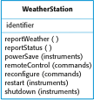
Figure 8.4 The weather station object interface

Slide 6
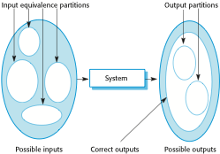
Figure 8.5 Equivalence partitioning

Slide 7
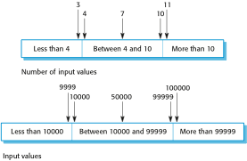
Figure 8.6 Equivalence partitions

Slide 8
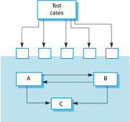
Figure 8.7 Interface testing

Slide 9
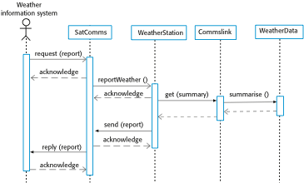
Figure 8.8 Collect weather data sequence chart

Slide 10

Figure 8.9 Test-driven development

Slide 11
Figure 8.10 A usage scenario for the MHC-PMS
Kate is a nurse who specializes in mental health care. One of her responsibilities is to visit patients at home to check that their treatment is effective and that they are not suffering from medication side -effects.
On a day for home visits, Kate logs into the MHC-PMS and uses it to print her schedule of home visits for that day, along with summary information about the patients to be visited. She requests that the records for these patients be downloaded to her laptop. She is prompted for her key phrase to encrypt the records on the laptop.
One of the patients that she visits is Jim, who is being treated with medication for depression. Jim feels that the medication is helping him but believes that it has the side -effect of keeping him awake at night. Kate looks up Jim’s record and is prompted for her key phrase to decrypt the record. She checks the drug prescribed and queries its side effects. Sleeplessness is a known side effect so she notes the problem in Jim’s record and suggests that he visits the clinic to have his medication changed. He agrees so Kate enters a prompt to call him when she gets back to the clinic to make an appointment with a physician. She ends the consultation and the system re-encrypts Jim’s record.
After, finishing her consultations, Kate returns to the clinic and uploads the records of patients visited to the database. The system generates a call list for Kate of those patients who she has to contact for follow-up information and make clinic appointments.

Slide 12

Figure 8.11 The acceptance testing process

